Slide 1
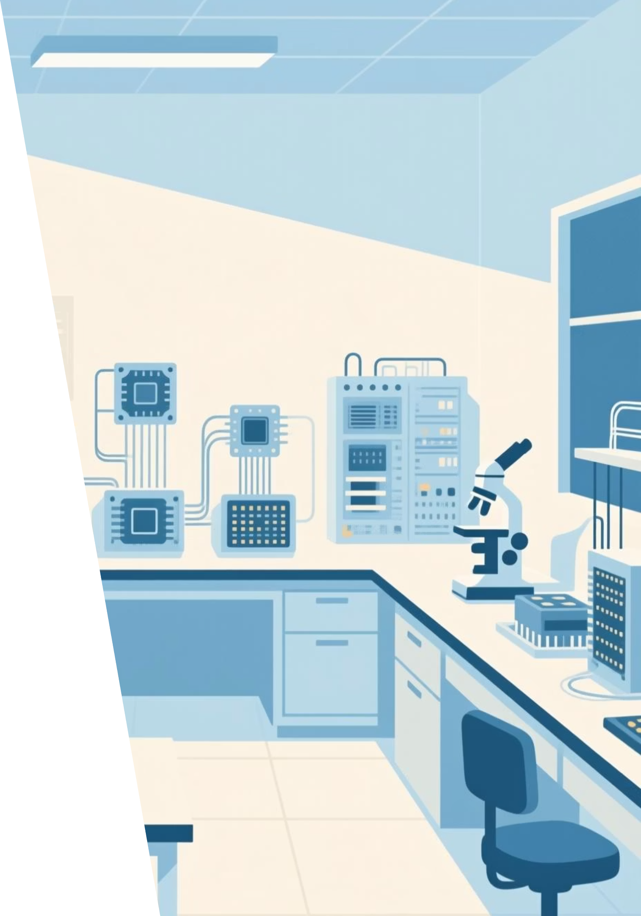
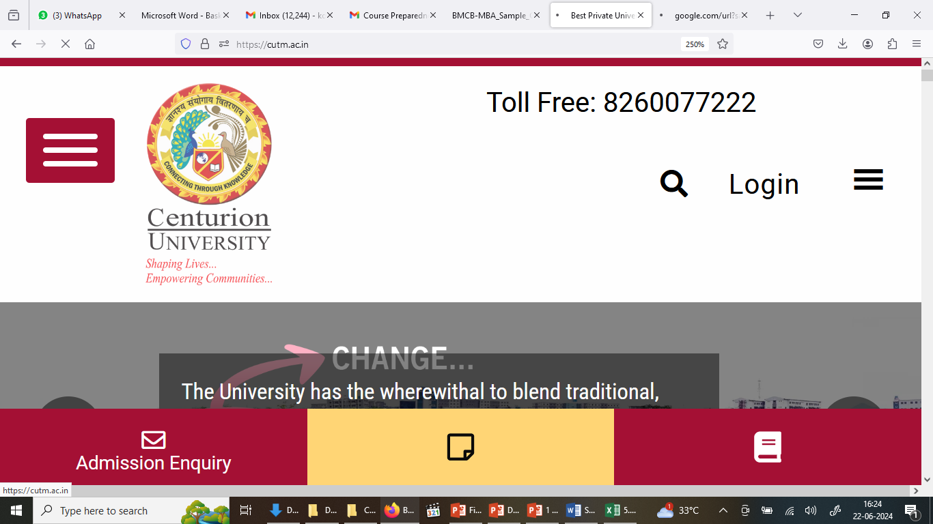
QUBITS,REPRESENTING QUBIT STATES, DIRAC BRAKET
NOTATION , REPRESENTING QUBIT STATES
TEAM MEMBERS | REG. NO
Pritam Das | 230301120006
Anwesh Mohanty | 240301120207
Biswa Ranjan Ranasingh | 240301120214

Slide 2
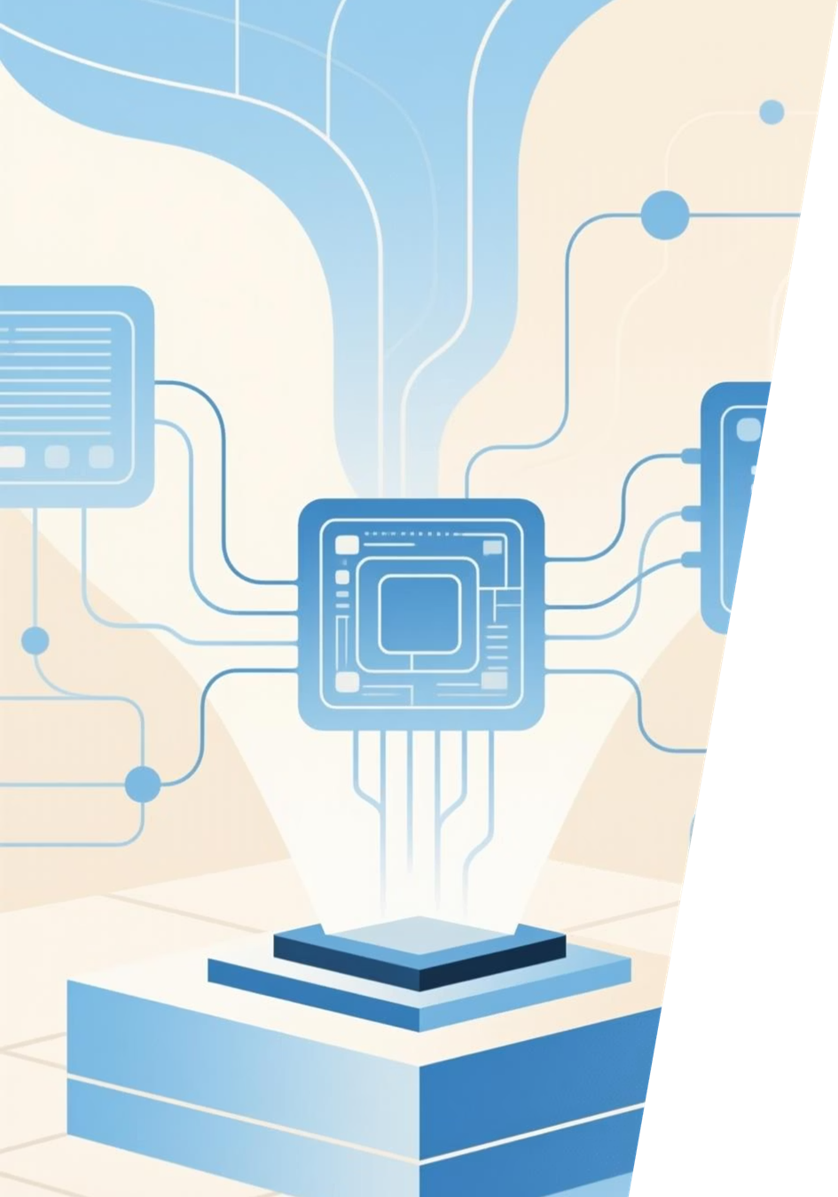
CONTENTS
1- Introduction
2-What is a Qubit?
3-Representing Qubit States
4-Dirac Bra–Ket Notation
5-Computational Basis States
6-Superposition and Measurement
7-Quantum Gates in Dirac Notation
8-Multiple Qubits and Tensor Products
9-Why Dirac Notation Matters
10-Conclusion

Slide 3
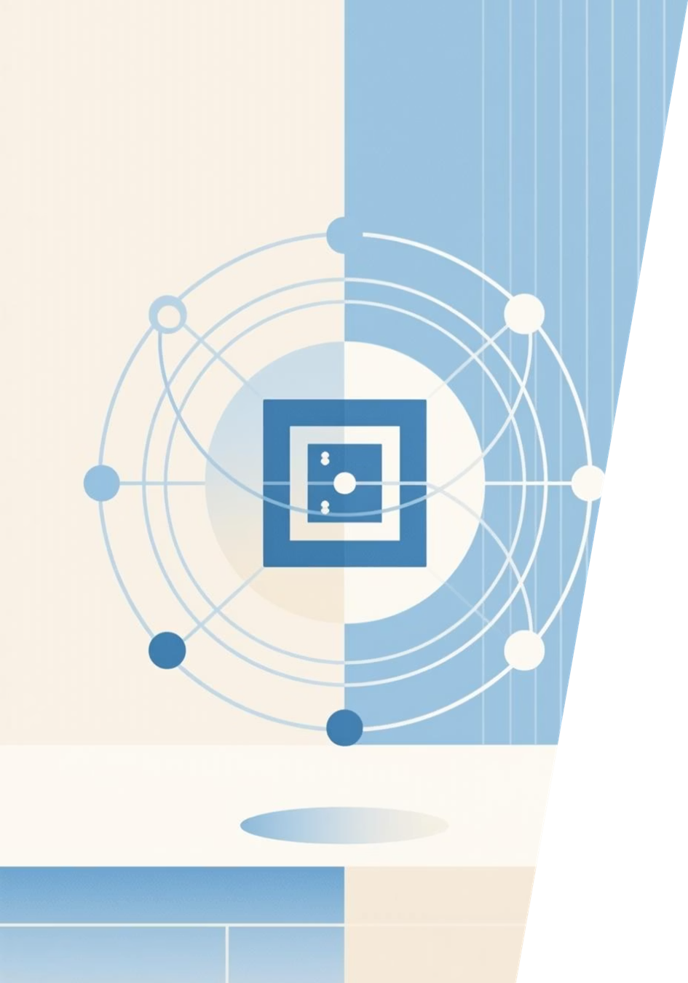
What is a Qubit?
The qubit is the fundamental unit of quantum information. Unlike classical bits that exist as either 0 or 1, qubits harness quantum mechanics to exist in superposition—simultaneously representing both states.
The Quantum Difference
Classical bits are binary: definitively 0 or 1. Qubits leverage quantum superposition to be both 0 and 1 at once until measured.
Physical Realizations
Qubits are implemented through electron spin, photon polarization, atomic excitations, and other quantum systems, each offering unique advantages for quantum computing.

Slide 4
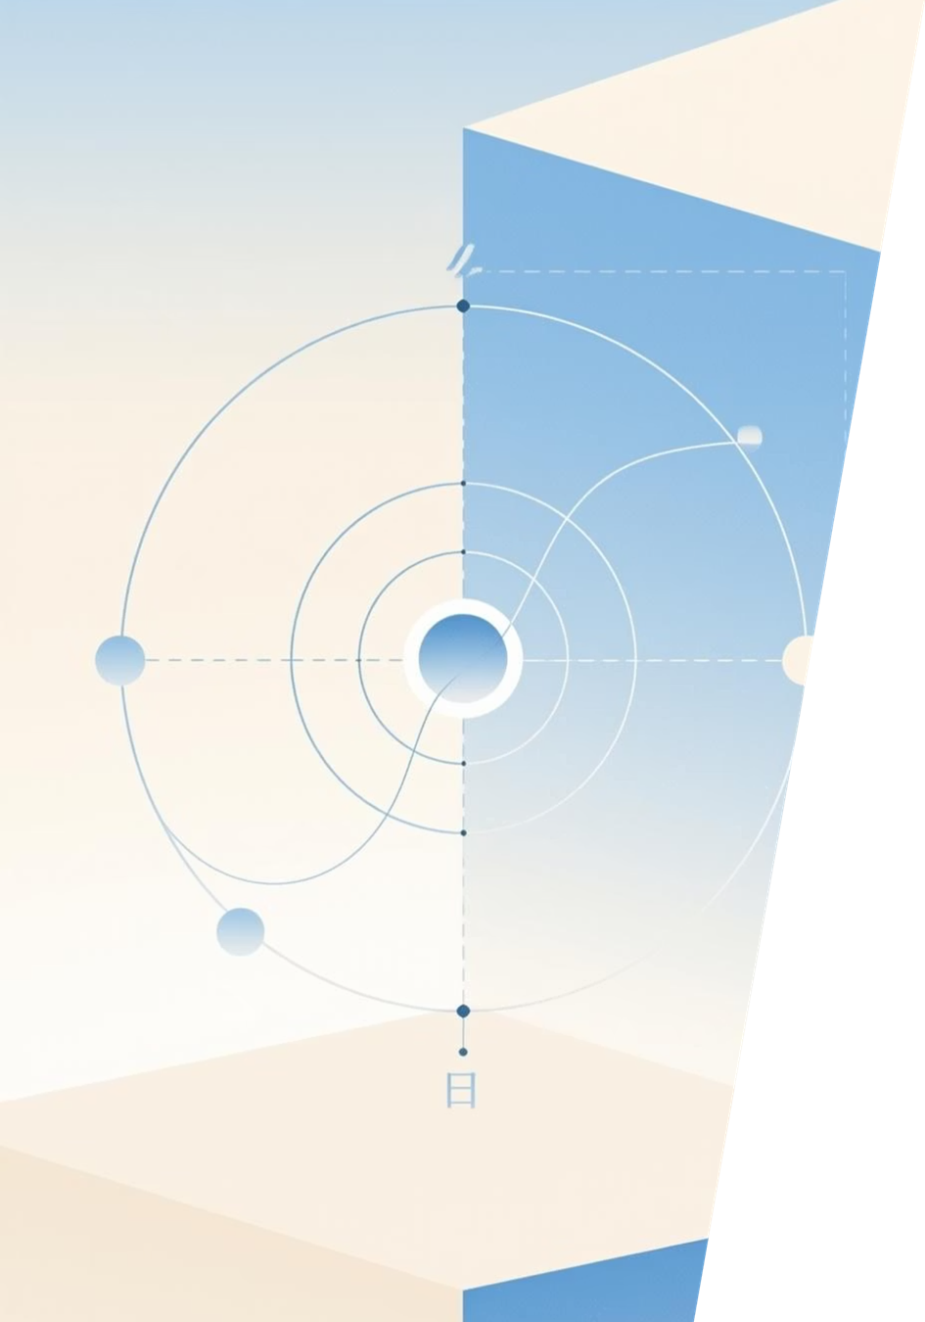
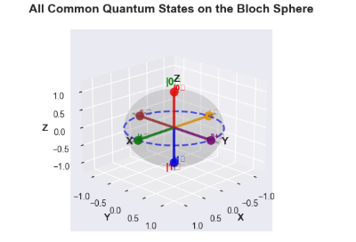
Representing Qubit States: The Basics
Classical vs Quantum
The General Qubit State
Classical bit: Either 0 or 1, nothing in between.
|ψ⟩ = α|0⟩ + β|1⟩
Where α and β are complex probability amplitudes, and |α|² + |β|² = 1 (normalization).
Qubit state: A vector in 2-dimensional complex space, combining both basis states.

Slide 5
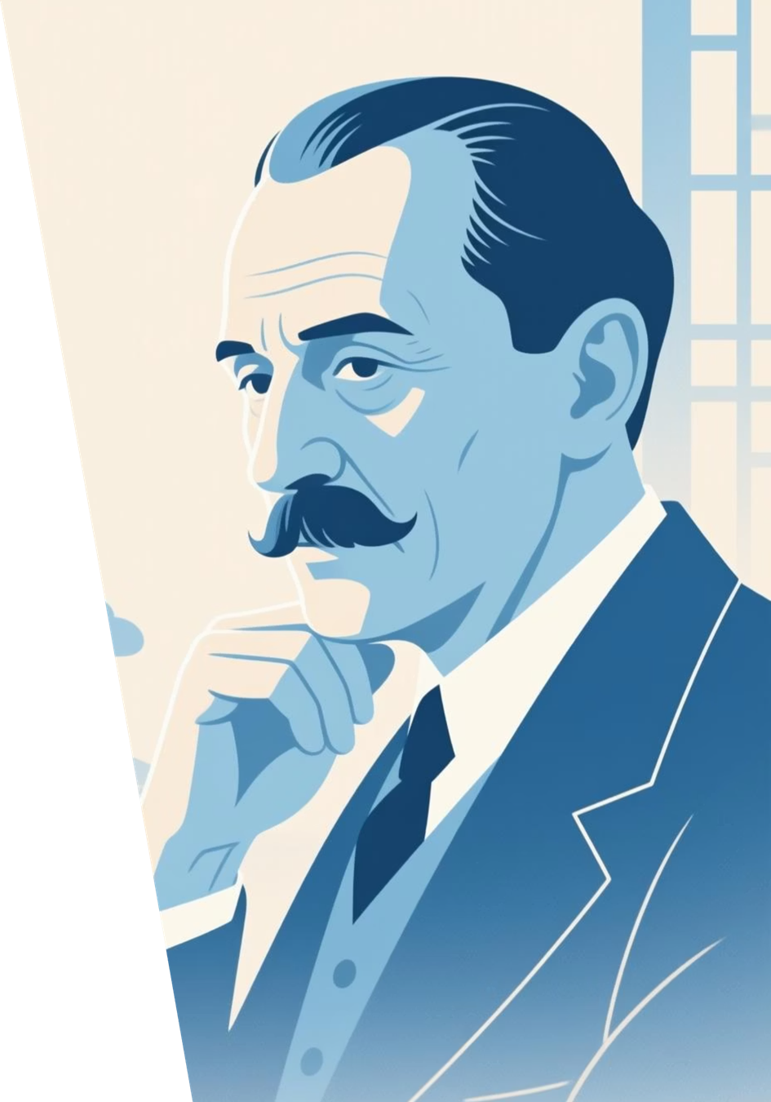

Dirac Bra-Ket Notation: The Language of Quantum States
Mathematician Paul Dirac introduced a revolutionary notation system that became the universal language of quantum mechanics, making complex quantum expressions elegantly concise.
Ket Vector |ψ⟩
Represents quantum states as column vectors. This is the state of your quantum system.
Bra Vector ⟨ψ|
The conjugate transpose (row vector) of a ket. Used to measure overlaps and probabilities
Inner Product ⟨φ|ψ⟩
Gives the amplitude of overlap between two states, fundamental to quantum probability calculations.

Slide 6
Computational Basis States in Dirac Notation
The foundation of qubit representation rests on two orthonormal basis states that correspond to classical 0 and 1, establishing the reference frame for all quantum states.
State | Vector From | classical
|0⟩ | [1, 0]ᵀ | 0
|1⟩ | 0, 1]ᵀ | 1
⟨0|1⟩ | 0 | Orthogonal
⟨0|0⟩ = ⟨1|1⟩ | 1 | Normalized

Slide 7
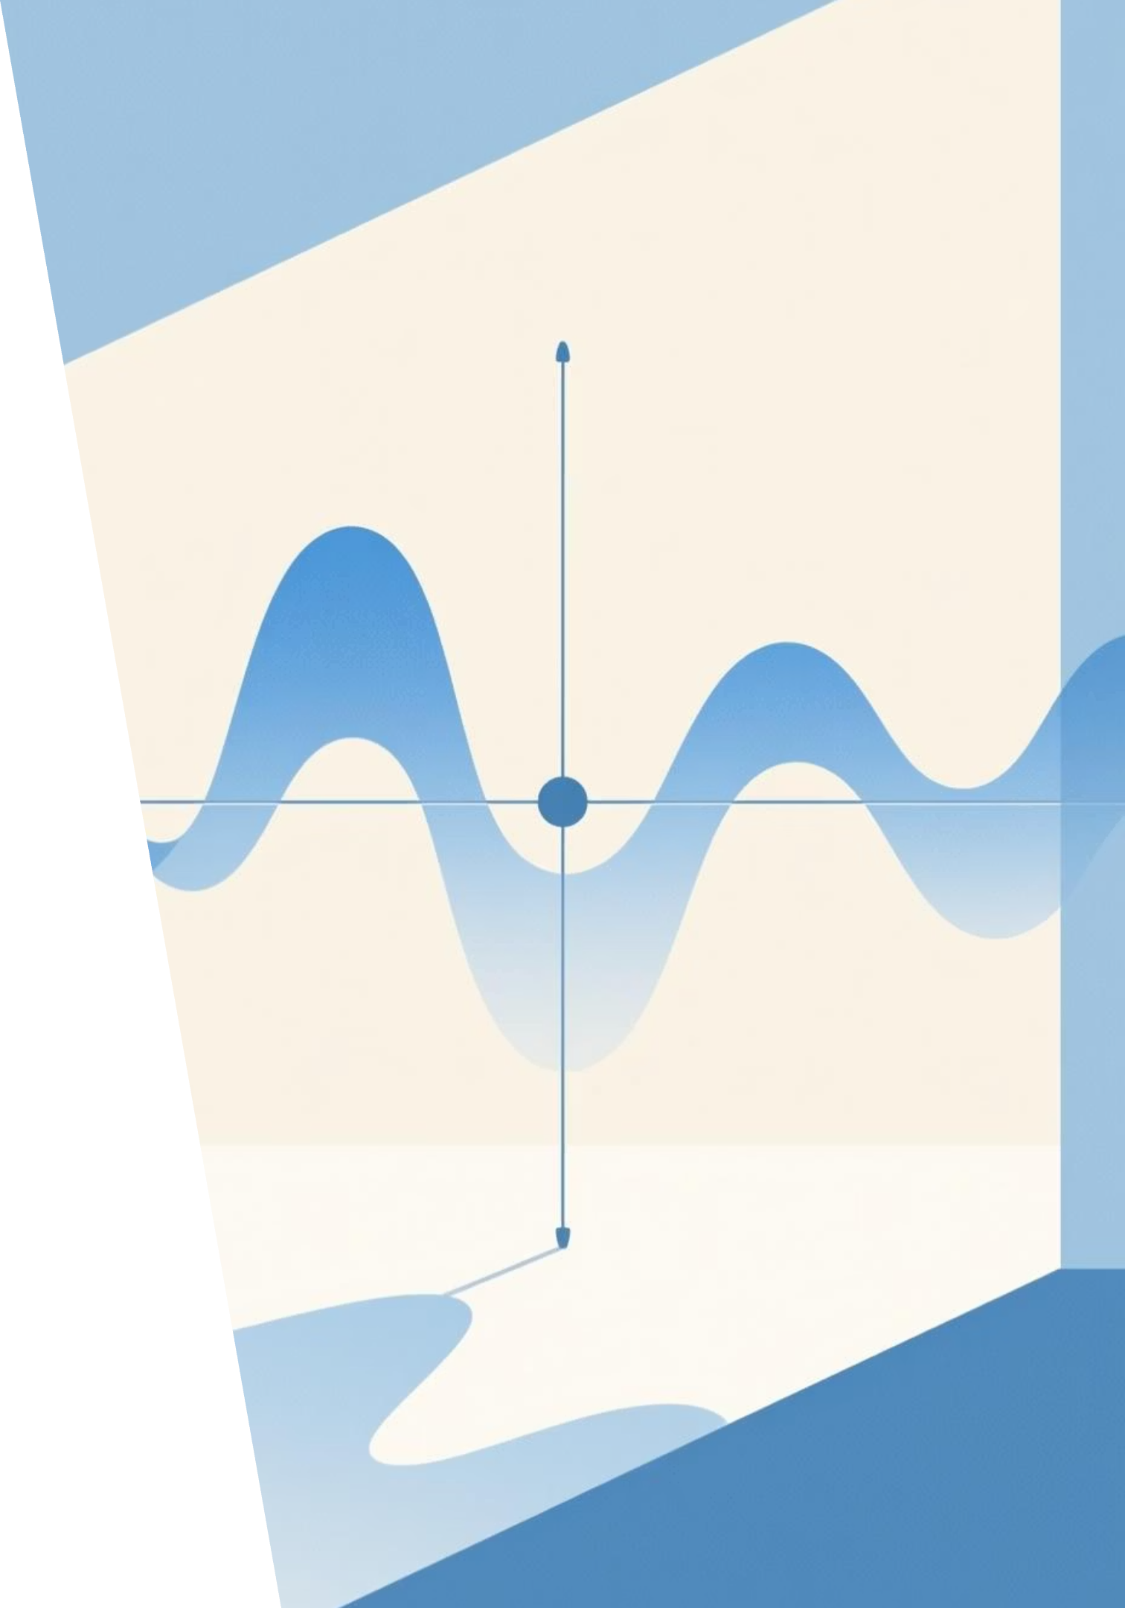
Superposition and Measurement
Equal Superposition
|ψ⟩ = (1/√2)(|0⟩ + |1⟩) represents a perfectly balanced superposition where the qubit is equally likely to be measured as 0 or 1.
Measurement Probabilities
p(0) = |α|² and p(1) = |β|². Upon measurement, the quantum state collapses to either |0⟩ or |1⟩ with these respective probabilities

Slide 8
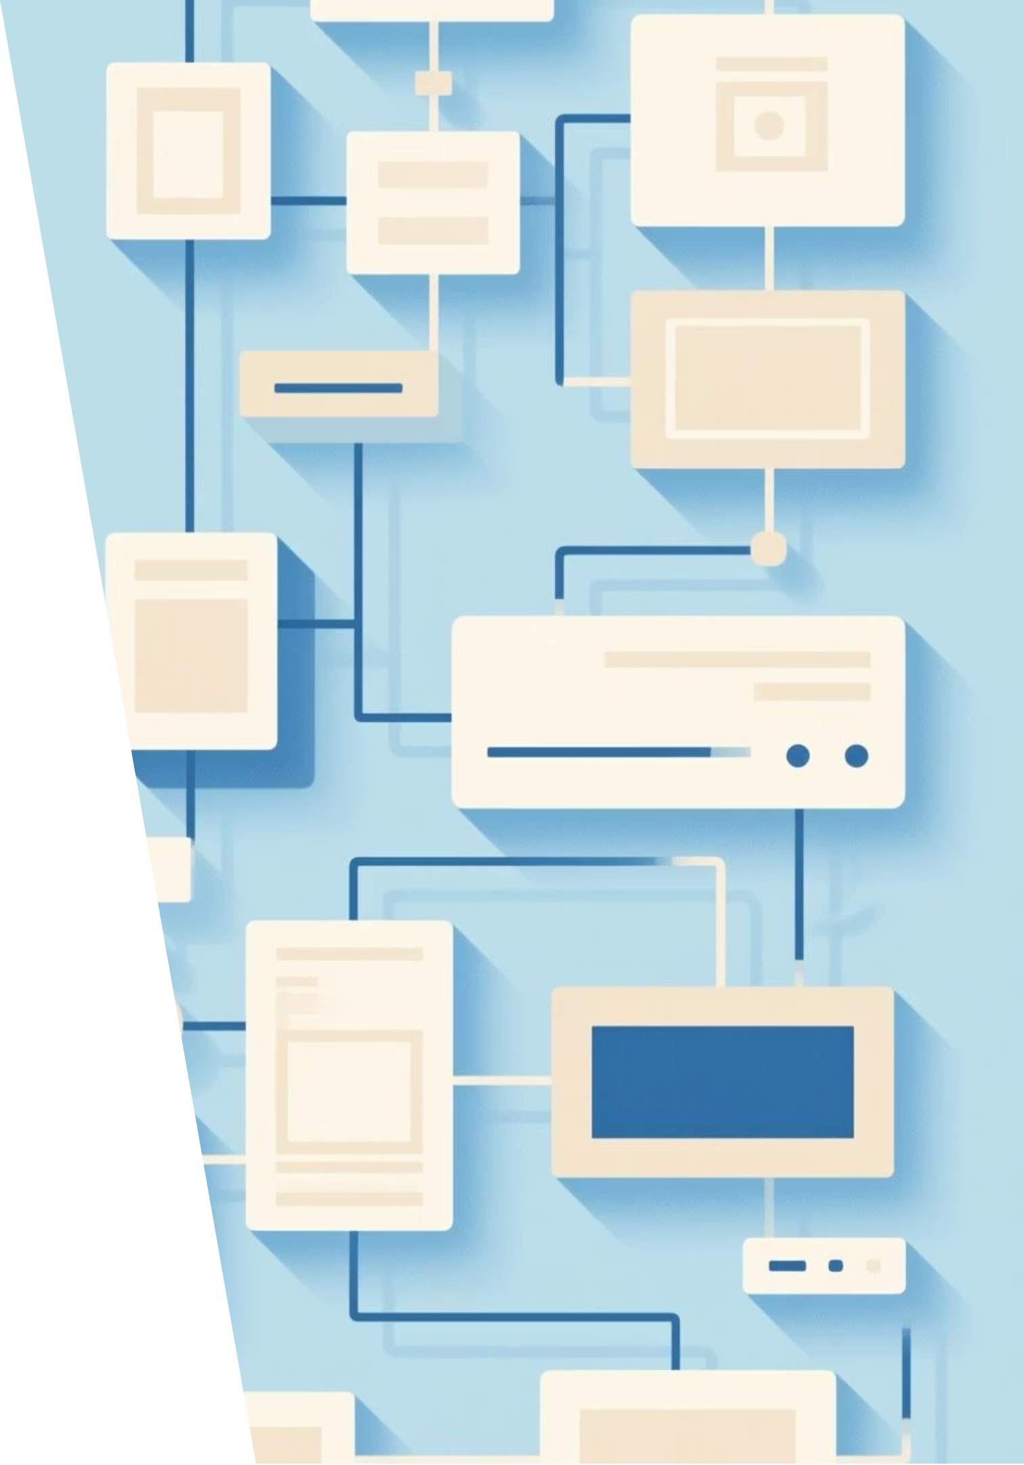
Multiple Qubits and Tensor Products
Multiple qubits combine using tensor products to create exponentially larger state spaces, enabling representation of entanglement and complex quantum phenomena essential for quantum computing power.
Two-Qubit Space:-
4-dimensional Hilbert space with basis states |00⟩, |01⟩, |10⟩, |11⟩
Tensor Product:-
|ψ⟩ ⊗ |φ⟩ or |ψφ⟩ combines individual states into composite quantum systems.
Entanglemen:-
Tensor products enable description of entangled states where qubits correlate in ways impossible classically.
Scalability:-
N qubits span 2ᴺ-dimensional space—exponential scaling makes qubits remarkably powerful.

Slide 9
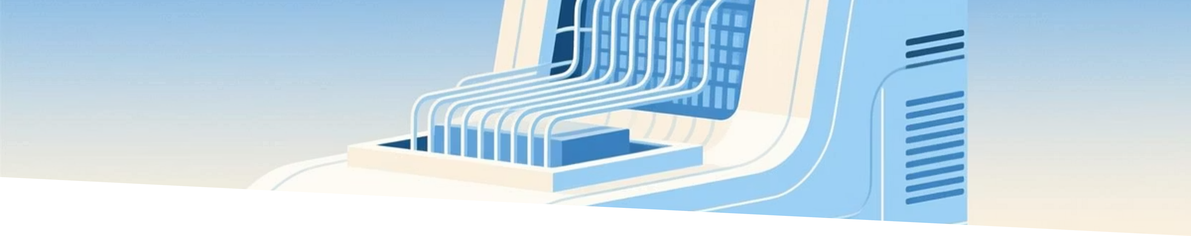
Conclusion:-
Qubits are the fundamental units of quantum information, extending classical bits through superposition and entanglement.
Quantum state representation using complex probability amplitudes provides a richer, multidimensional information structure
Dirac Bra–Ket Notation offers a powerful and elegant mathematical framework to describe and manipulate quantum states.
Together, these concepts form the foundation of quantum computing, enabling precise formulation of quantum algorithms and operations.
Mastering these basics opens the path toward understanding quantum gates, quantum circuits, and the future of computation.

Slide 10

Any Query
DEPARTMENT OF COMPUTER SCIENCE & ENGINEERING
SCHOOL OF ENGINEERING AND TECHNOLOGY, CUTM, BHUBANESWAR, ODISHA

Slide 11
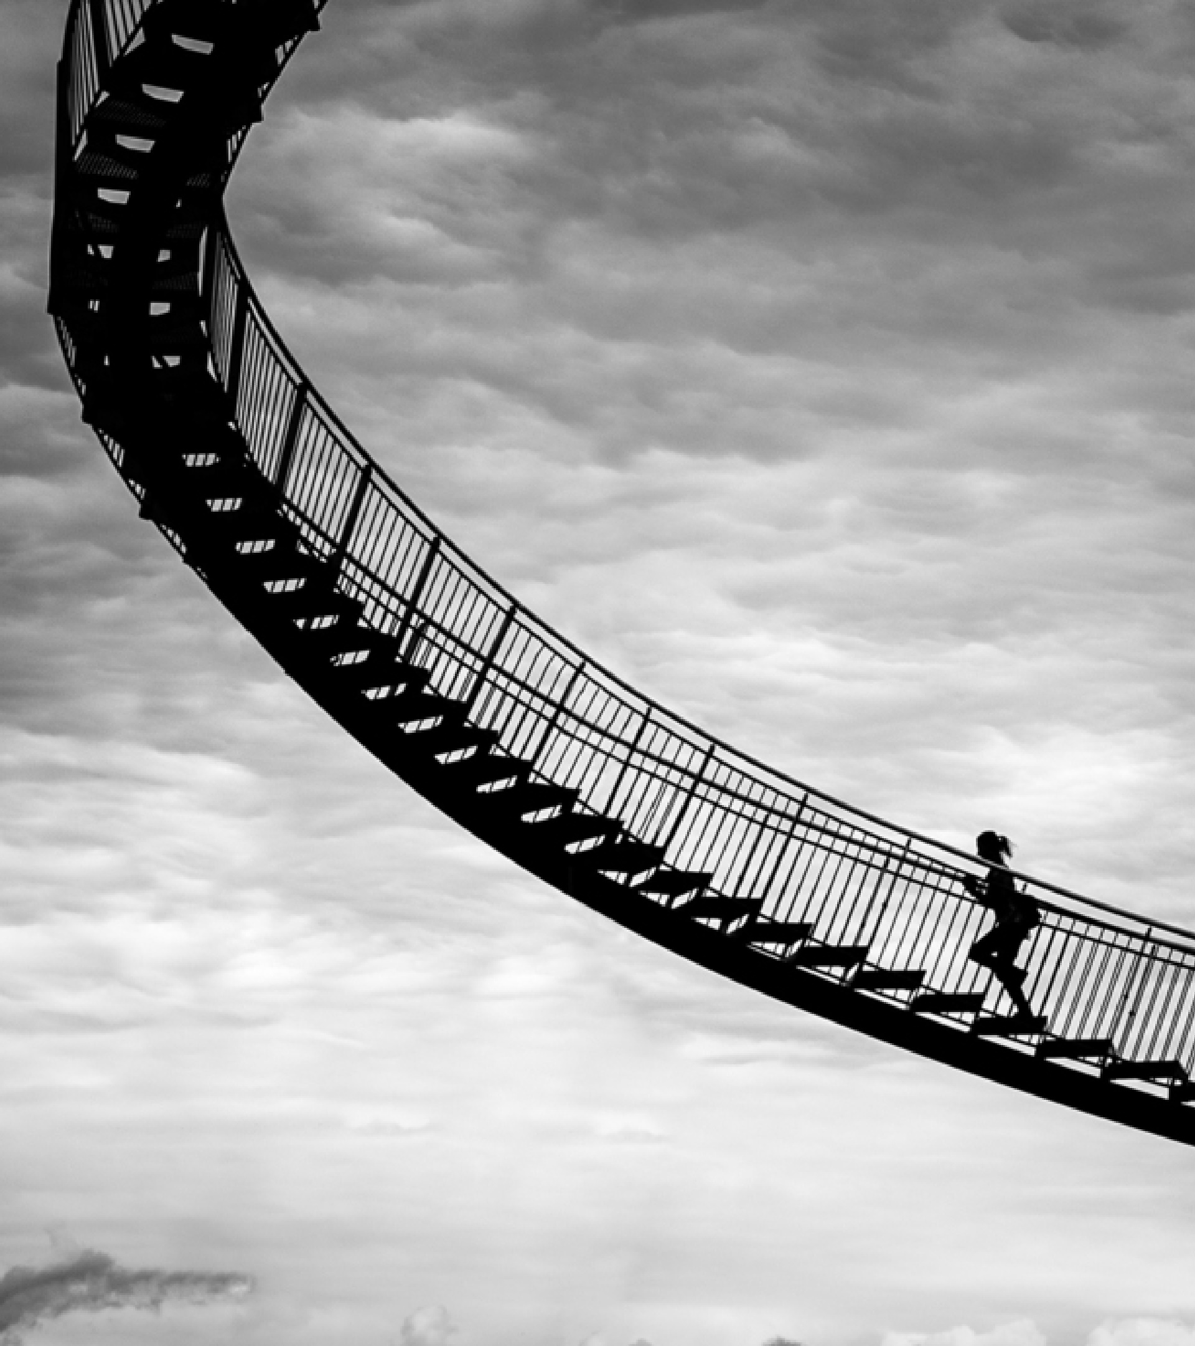
Thank you
Supervised By: Dr. Bhairav Ku. Majhi
Prof., Department of CSE, CUTM, BBSR
DEPARTMENT OF COMPUTER SCIENCE & ENGINEERING
SCHOOL OF ENGINEERING AND TECHNOLOGY, CUTM, BHUBANESWAR, ODISHA

